Slide 1
The Gold Foil Experiment
by Earnest Rutherford
What is showed him (us) about the way atoms are built.

Slide 2
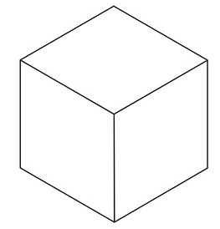
Radioactive polonium metal in a lead box. The polonium emits alpha particles, with mass of 4 amu
and charge of +2. They are “aimed” at the gold foil. Here only one atom of the foil is in the diagram, but it’s enough to learn how this works.
Polonium

Slide 3
The alpha particles are emitted constantly at the same rate, and can be detected, if they hit a screen that is coated by zinc sulfide (ZnS). A little flash of light can be seen with your eyes.
Polonium

Slide 4
Where an alpha particles hits the screen, a little flash of light can be seen.
Polonium

Slide 5
This happens over and over, as if ALL of the metal is not really there. The alpha particles just go through the foil. Here the alpha particles go through just one atom.
Polonium

Slide 6
Again…
Polonium

Slide 7
Sometimes an alpha particle appears to be sent off at a wide angle, as if it HIT something bigger that diverted it.
Polonium

Slide 8
But most alpha particles seem to fly right through the foil, hitting the screen straight on.
Polonium

Slide 9
Over and over, like the foil is not even there.
Polonium

Slide 10
Scientists can count the flashes, that match the rate of flashes when the foil is taken away from the experiment. Over and over.
Polonium

Slide 11
Like a clock, all the alpha particles go through the foil (here it is just one atom).
Polonium

Slide 12
Rarely it seems that an alpha particle is bounced BACKWARDS (the red line here)
Polonium

Slide 13
What did Rutherford make of his experiment?
Polonium

Slide 14
The early “model” of the atom, by
John Dalton (who did give us the atomic theory) had described atoms in a sort of simple way.
He said that atoms were hard spheres (the gray here), where the mass of the atom was, and were neutral.
The black lines represent what
alpha particles would do when shot
at atoms built like this. All the alpha particles should bounce off the foil,
if atoms were built like Dalton described.
Dalton atom model
Atomic foil

Slide 15
The next “model” of the atom, by
JJ Thomson (who did discover the electron and who was brilliant beyond words) had described atoms in a sort of
funny way.
He said that atoms were composed of “positive” stuff (the orange here), with electrons imbedded into it.
The black lines represent what alpha particles would do when shot at atoms built like this. All the alpha particles should fly right through the foil,
if atoms were built like this.
Thomson atom model

Slide 16
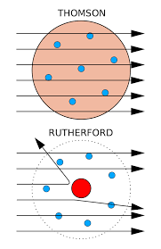
Since that is NOT what the alpha particles did in the gold foil experiment, Rutherford imagined the atoms having a volume made up of the negative electrons flying around a small dense center, which contained nearly all the atom’s mass and positive charge.
The balance of charges kept atoms neutral (which they seemed to be and are), but this explanation allowed Rutherford to explain why alpha particles were sometimes sent unexpected, odd angles.
Thomson atom model
Rutherford atom model

Slide 17
The positive alpha particles banged into much larger positive nuclei, but not often. When they did, they were given a bump at an angle.
Rarely the alpha particles hit straight on, and the alpha particles were bounced backwards.
Rutherford atom model

Slide 18
Rutherford concluded this….
Atoms are mostly empty space (the electrons fly around a very small dense, positive nucleus.
The Nucleus contained nearly all of the mass of an atom.
The electrons made up nearly all of the volume of an atom
The positive and negatives were equal, the atoms were neutral.
The alpha particles flew easily through the atoms, unless they happened to clip a nucleus.
Depending upon the “ding”, alpha particles could be diverted from the straight path they were on, or even reversed!
Somehow the electrons stayed in orbit around the nuclei, in some ways like planets stayed in orbit around the Sun.
Although that was (is) true, it was very hard to prove, and Rutherford could not do it himself, he had help from Neils Bohr.

Slide 19
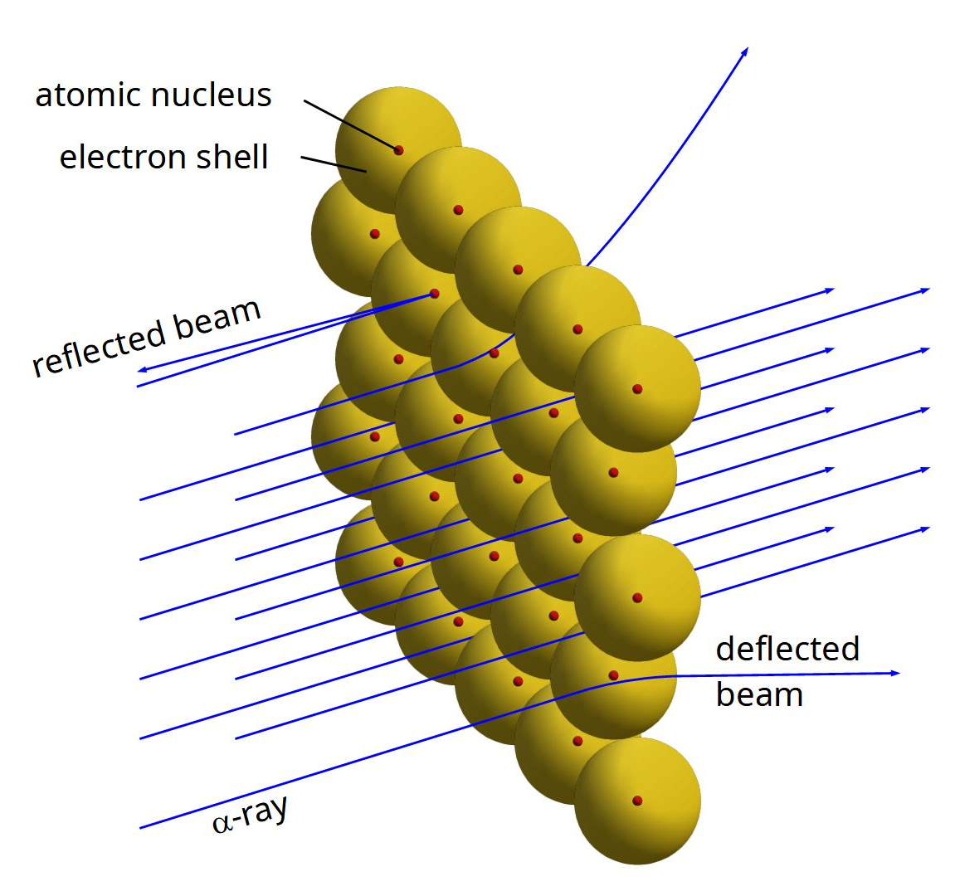
In this diagram, all the alpha particles are coming from the LEFT, shooting at a sheet of gold atoms only one layer thick (for diagrammatic purposes, it’s too thin to exist).
It shows how MOST alpha particles travelling in line with the BLUE LINES, go straight through the atoms.
Some are deflected, some that hit a nucleus of a gold atom.
In this diagram, no alpha particles
are bounced in reverse.
Electron Shell = Electron Orbitals

Slide 20
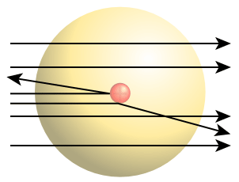
This is but a single atom of gold, with many alpha particles (the black lines) going right through it
-- as if it weren’t even there.
The reason so many alpha particles “miss” the nucleus, it’s said that if the nucleus were the size of a period at the end of this sentence, the volume of the atom is about the size of your house.
I realize that this is hard to grasp, but it’s true.
And that is why 99% of the alpha particles have no trouble getting through a many atoms thick layer of gold foil. However thin you can imagine that, most likely at least 100’s of atoms thick.

